Slide 1

Information Retrieval

Slide 2

Outline
Search
Information Retrieval
History
Syllabus
Conclusion

Slide 3
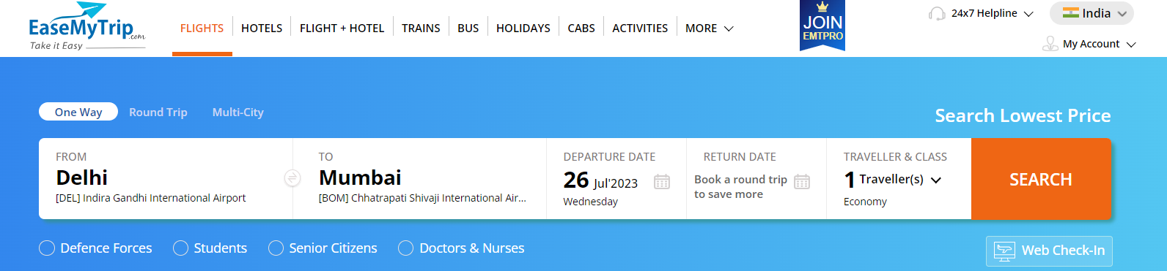
Search in Various Fields
In
Sports
Travel
Entertainment
Education
E-commerce
Healthcare

Slide 4



What is information Retrieval
Information Need
I want to know about
BIT
Collection
d1: “BIT Mesra”
d2: “IIIT Ranchi”
Query=“BIT”
Retrieval
System

Slide 5

Information Retrieval
Gerard Salton proposed the definition of information retrieval as:
Information retrieval is a field concerned with the structure, analysis, organization, storage, searching, and retrieval of information

Slide 6
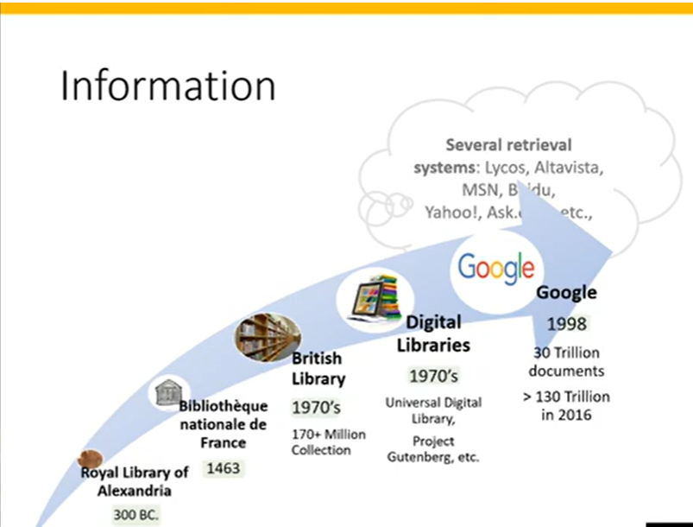

Slide 7
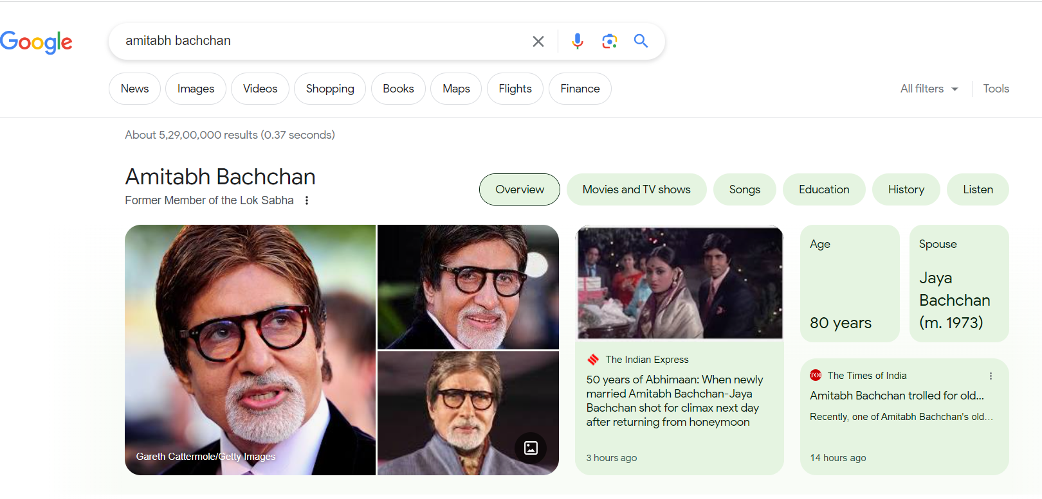

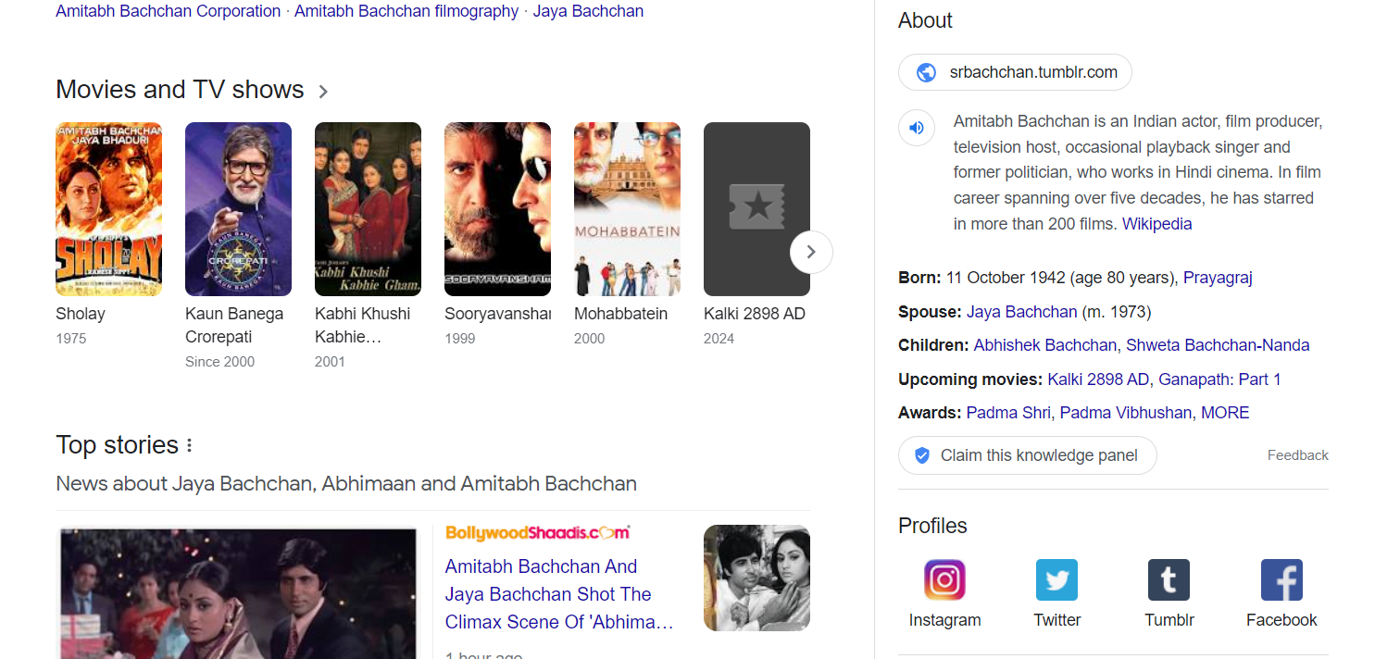

Slide 8


Deprival of information

Slide 9
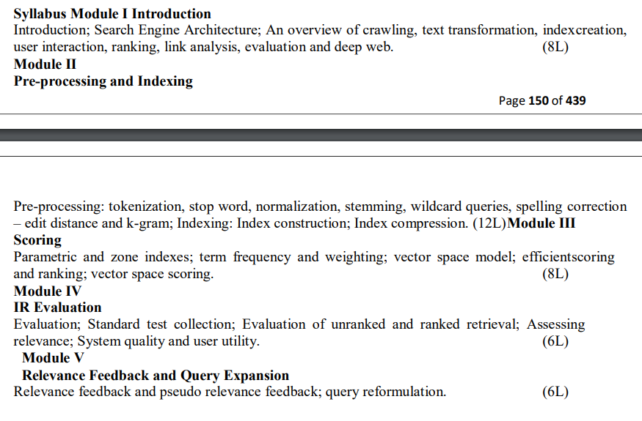
Syllabus

Slide 10
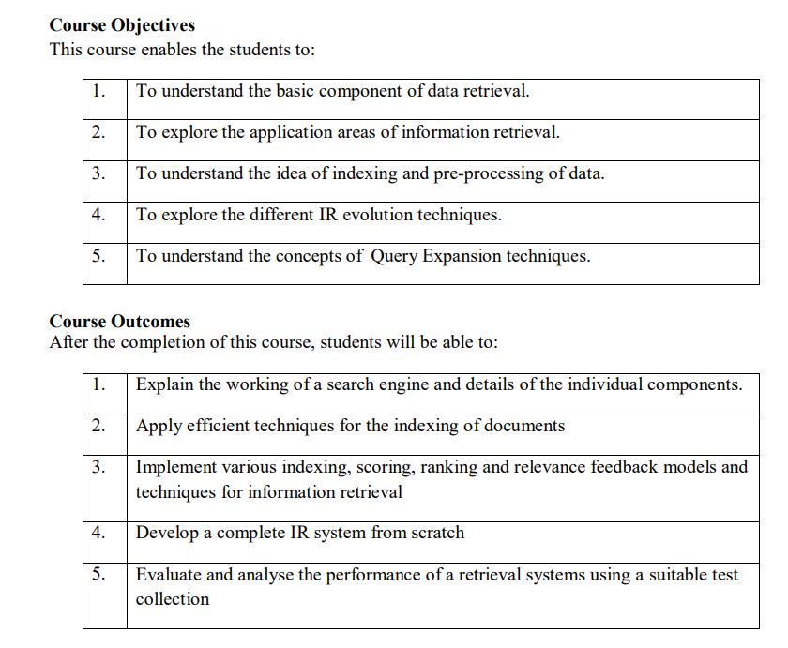
About Course Outcome

Slide 11

Evaluation

